Slide 1
NAO prediction
Machine Learning with TensorFlow Project by:
Anil Kumar Gadamoni, Murali, Paula Gößling
February 2026

Slide 2
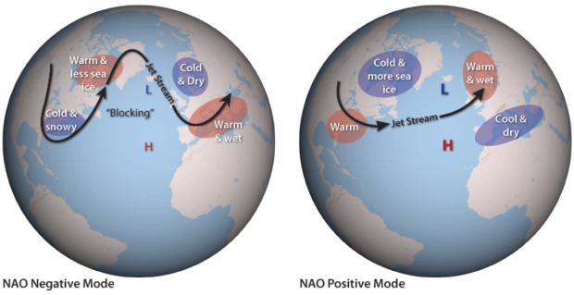
Introduction: Who is NAO? Paula
North Atlantic Oscillation
negative Phase
→ cold winter for Kiel
Notes:
NAO is short for NorthAtl… What do you see here? Map of North Atlantic. Here two pressure systems are dominant, the icelandic low and the azores high. But there strengths changes with time. When they are more pronounced then usually the …

Slide 3
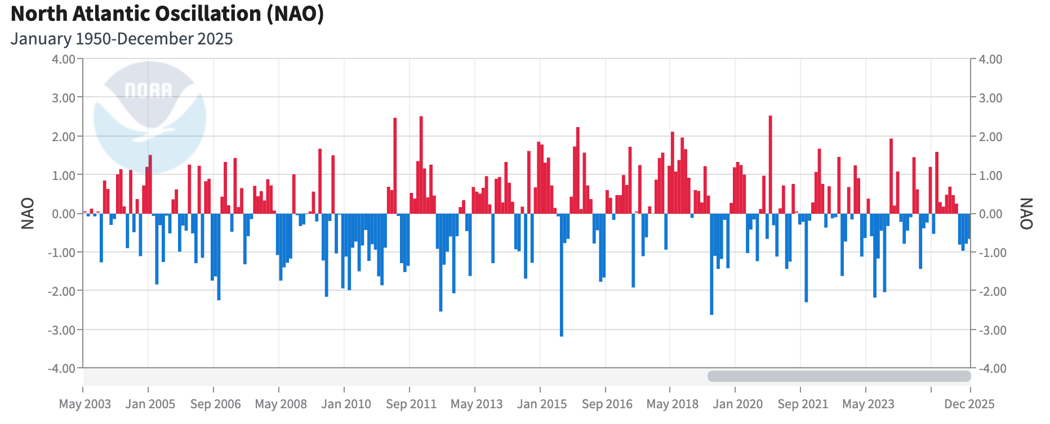
Introduction: NAO Index Paula

Slide 4
Literature Survey 1
Foundation and Predictability of the Atlantic Sector
Based on Source 1: A Review of Predictability Studies (JCLI)
Objective & Methodology
Comprehensive assessment of North Atlantic climate and NAO predictability over decadal timescales.
Comparison of observational data, statistical models, and decadal hindcast experiments.
Key Findings
Limited Predictability: Skill exists but is heavily modulated by Ocean-Atmosphere coupling and Sea Surface Temperature (SST) anomalies.
Seasonal Variance: Winter NAO exhibits the highest potential for prediction skill.
Challenges: High levels of internal atmospheric noise and model bias remain significant barriers to short-term transition accuracy.
Strategic Relevance to Our Project
Baseline Expectations: Provides a benchmark for what is "predictable" versus "noise."
Feature Selection: Validates the use of SST and ocean circulation as critical predictors for machine learning inputs.

Slide 5
Literature Survey 2
Deep Learning & Causal Discovery in NAO Forecasting
Based on Source 2: Multivariate Air–Sea Coupled Model (Atmosphere, 2023)
The Approach: NAO-MCD Model
Feature Engineering: Uses data-driven causal discovery to select statistically significant predictors (ENSO, Sea Ice, 500hPa Geopotential Height, Wind).
Architecture: A hybrid deep learning structure:
ConvLSTM: Encodes spatiotemporal features.
GCN (Graph Convolutional Network): Models air-sea coupling.
Symmetrical Decoder: Predicts Sea Level Pressure (SLP) to derive the NAO index.
Performance Outcomes
Superiority: Outperformed traditional numerical models at 2- to 6-month lead times.
Stability: Confirmed that winter forecasting is significantly more robust than other seasons.
Direct Application to Our Project
Model Design: Suggests that adding a spatial component (using ConvLSTM or GCN) may yield better results than 1D time-series data alone.
Refinement: We should consider focusing on winter-specific models to maximize initial success.

Slide 6
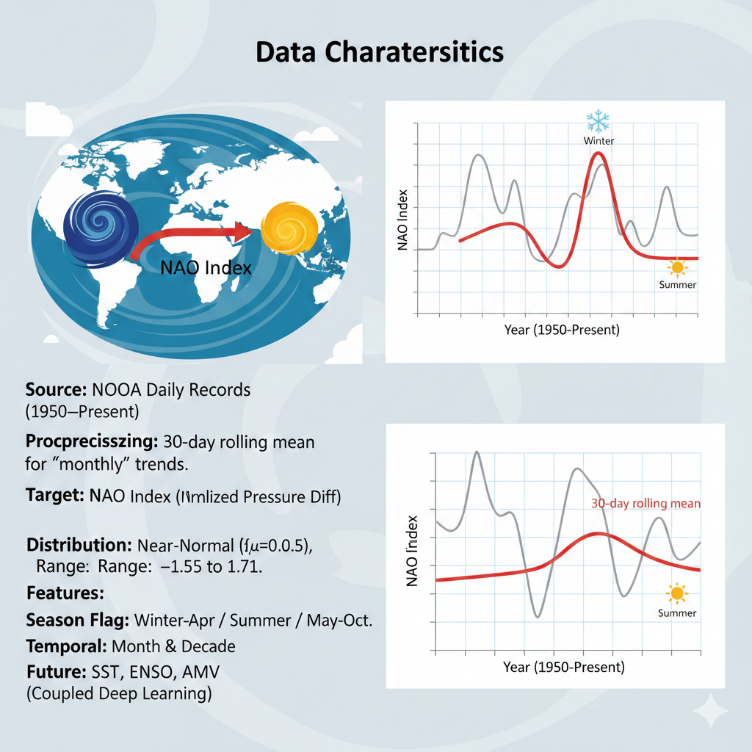
Data characteristics
Dataset Profile & Source
Provider: NOAA daily records from 1950 to present ($>27,700$ observations).
Preprocessing: Utilizes a 30-day rolling mean to smooth high-frequency atmospheric noise into a "monthly" trend while maintaining daily data steps.
Target Variable: NAO Index
Description: The normalized sea-level pressure difference between the Icelandic Low and the Azores High.
Statistical Traits: Nearly normal distribution ($\mu=0.03$, $\sigma=0.5$) with values ranging from -1.55 to 1.71.
Feature Engineering ($X$)
Season Flag: Binary classification (Winter: Nov–Apr / Summer: May–Oct) to capture the higher predictability of winter climate dynamics.
Temporal Features: Month and Decade markers to account for seasonality and long-term decadal shifts.
Future Expansion: Evaluating the integration of coupled features like SST (Sea Surface Temperature), ENSO, and AMV to improve deep learning performance.

Slide 7
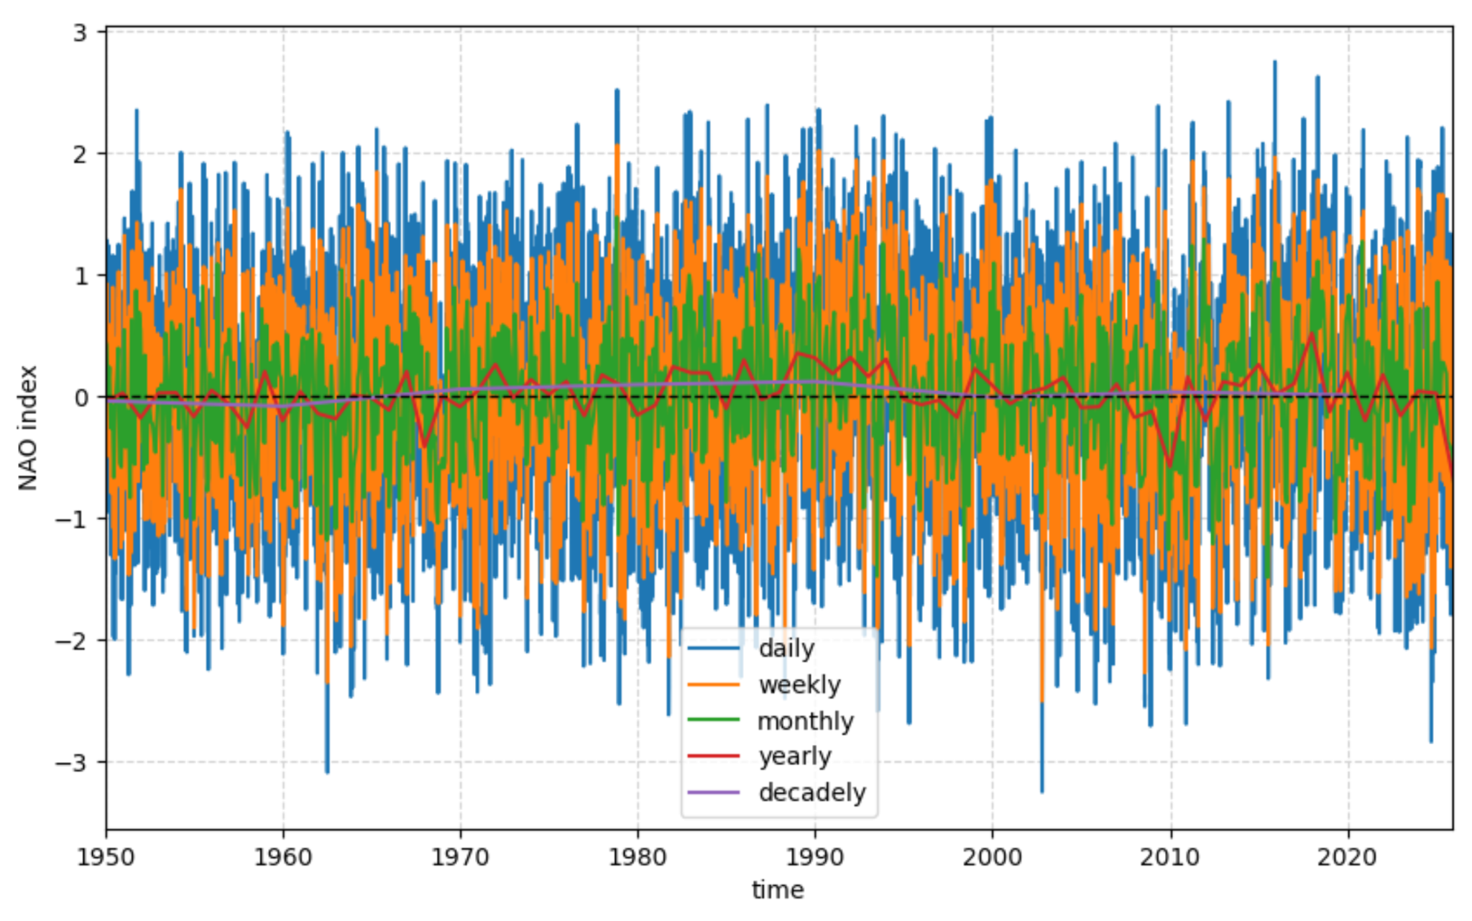
Data characteristics
daily > 27700 values → decided to take less noisy monthly values, 75 years x 356 days
Features:
month
season
year
decade
previous winter
autom- min, max, std, mean
10yr freq, 20yr freq

Slide 8
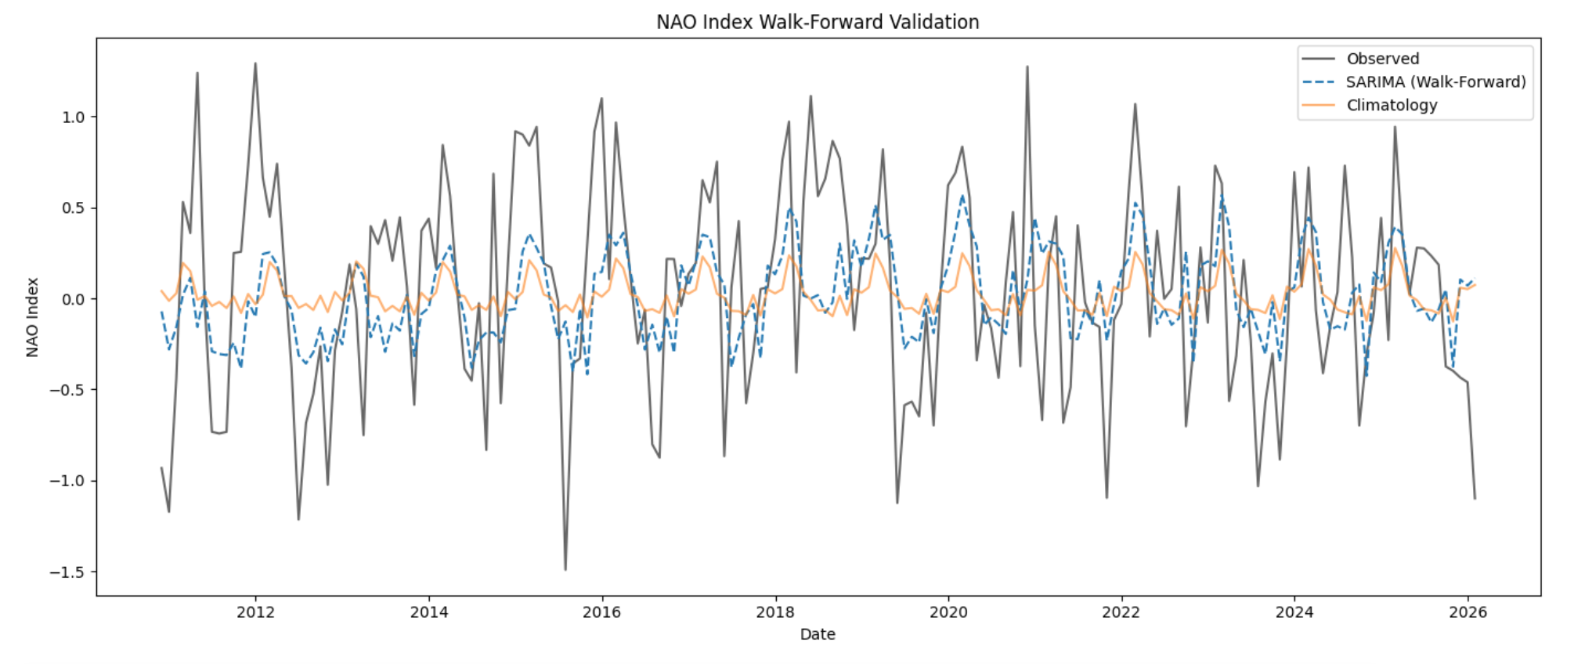
Baseline Model
FINAL EVALUATION RESULTS
MSE (Climatology): 0.2880
MSE (SARIMA): 0.2613
RMSE (Climatology): 0.5366
RMSE (SARIMA): 0.5112
ACC (Climatology): 0.3895
ACC (SARIMA): 0.4334

Slide 9
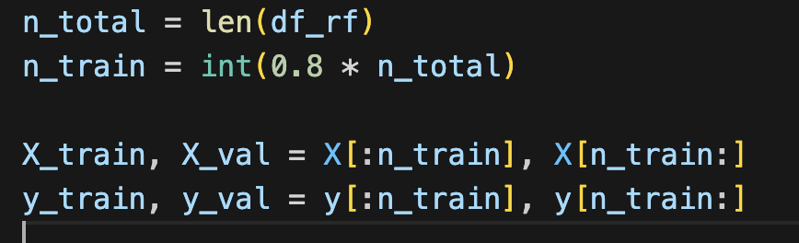
Model for NAO Prediction
Designed for: Nonlinear, high-variance time-series with complex interactions
Strengths: Captures nonlinear dynamics, handles multicollinearity, robust to noise
Limitations: Lower interpretability than linear models

Slide 10
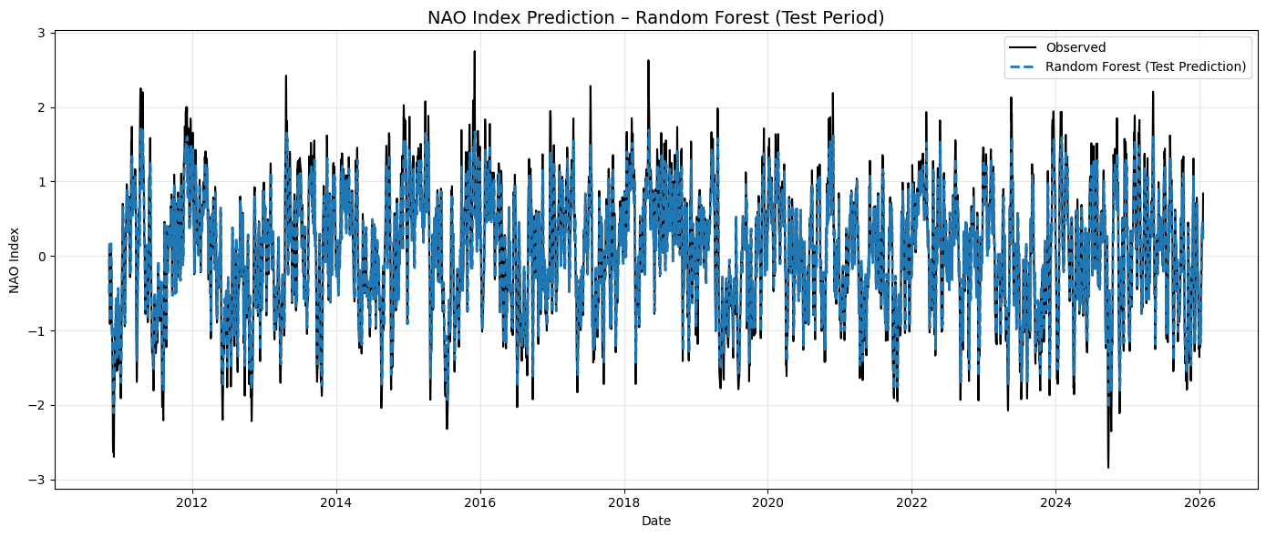
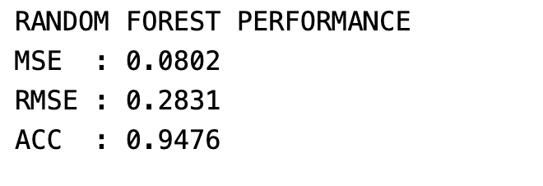
Results

Slide 11
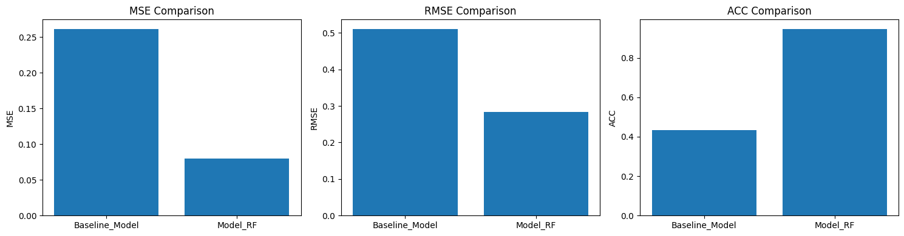
Baseline Model vs Model
Random Forest outperforms the baseline across all metrics
MSE and RMSE are significantly reduced
ACC improves from ~0.43 to ~0.95
Higher ACC indicates better phase and variability capture
Confirms superiority of nonlinear ML over linear baselines

Slide 12
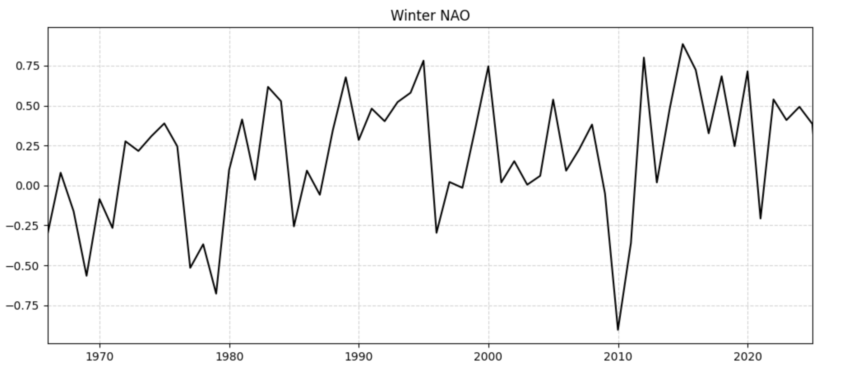
Only predict winter NAO
Winter Value is what we are interested in in the end.
→ only one value per year → somewhat small dataset, only 75 values
many features:
SON_features:mean,std,min,max
regime_features,
prev_winter,
lowfreq (10yr),
nao_lowfreq_20yr,
neg_extreme,
son_max_persistence, son_p10

Slide 13
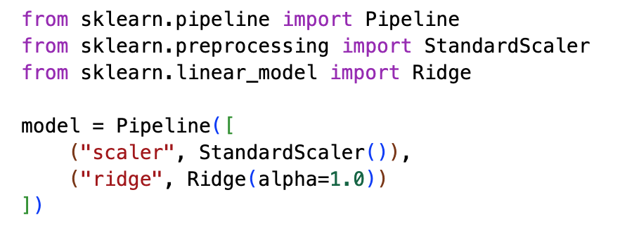
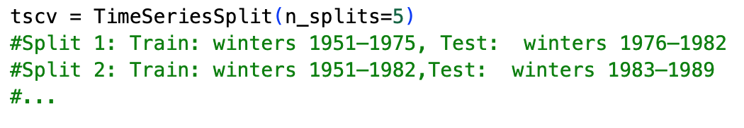
Only predict winter NAO: model description Ridge
Model class: Regularised linear regression (Ridge)
Designed for: Small-sample, noisy, correlated-predictor problems
Strengths: Stability, interpretability, robustness
Limitations: Cannot capture nonlinear or state-dependent dynamics

Slide 14
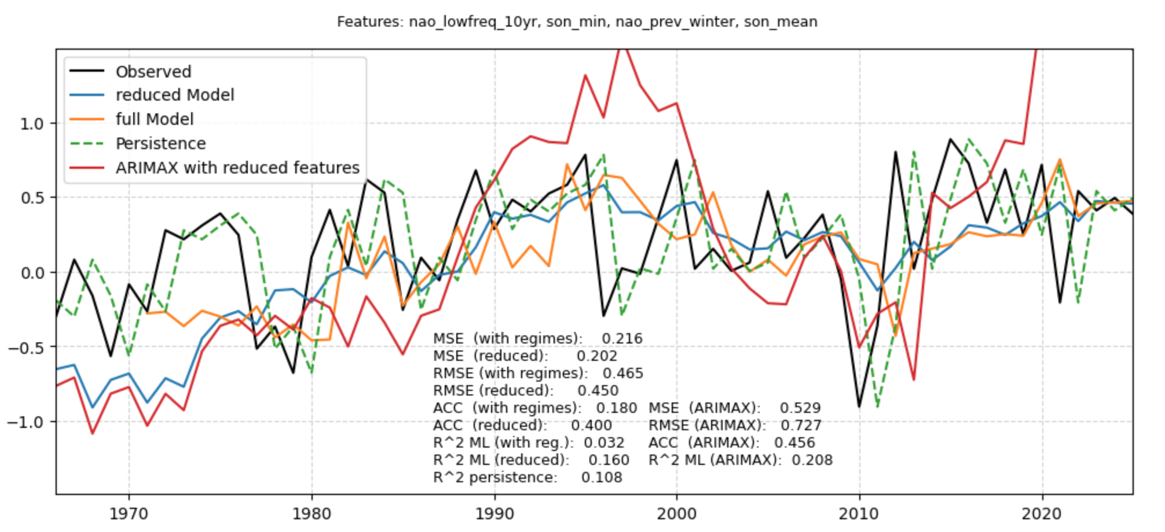
Only predict winter NAO: ARIMAX
anomaly sign and relative magnitude → ARIMAX
reducing absolute prediction error → Ridge
reduced model better: too many features don’t help…

Slide 15
Future work
“external” features: include ENSO, ocean features

Slide 16
Summary
prediction of monthly NAO index
Literature: so far not made with a lot of success
Random Forest: very high accuracy and low errors
only winter predict.: take better less but better features okaish prediction but no real live advantage…

